Slide 1



Globalization and MUI

Slide 2
Agenda
Globalization and MUI for SharePoint sites
Globalization and MUI for SharePoint apps
Globalization and MUI for SharePoint publishing sites

Slide 3
Globalization and MUI for SharePoint sites

Slide 4
Challenges to tackle
How to set the languages for a site
How to set the Time Zone and Region for a site
How to translate SharePoint UI elements using the client side API
Site title and description
List title and description
Content type name and description
Site column title and description
Other content (e.g. Navigation elements, site content,…)
Third party translation tools (coming)

Slide 5
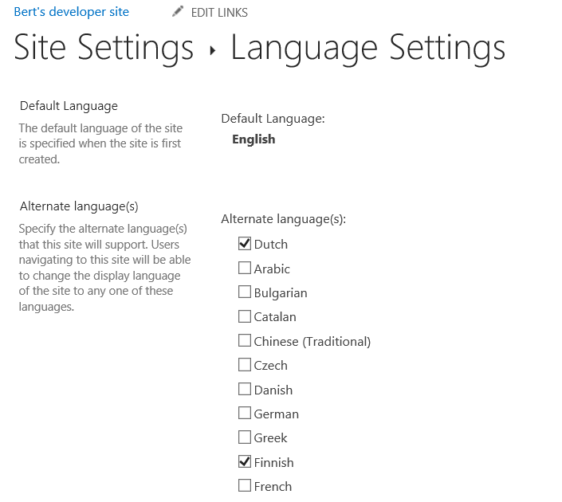
How to set the languages for a site
You want to automate the alternate language settings during site provisioning
Requires language packs to be installed
We’re working on getting support for this in the client API’s but currently the only option is to use browser HTTP post mimicking. http://blogs.msdn.com/b/vesku/archive/2013/11/04/ftc-to-cam-advance-http-remote-operations-for-sp2013.aspx describes this in more detail.
Reading is possible via the SupportedUILanguageIds web property in the client side API

Slide 6
Elements translated via language packs
Type of Content | Examples
Settings & Help | Settings Pages (_layouts, _admin) Help Images
Out of the Box Application Content | Menus Controls Custom Actions Web (Title, Description, Icon Description) List (Title, Description) Top Link bar (Links) Quick Launch (Links, Headings) Global Breadcrumb Local Breadcrumb Managed Metadata (Taxonomy) Site Content Types (Name, Description, Groups) List Content Types (Name, Description) Site Columns (Name, Description, Groups) List Columns (Name, Description)

Slide 7
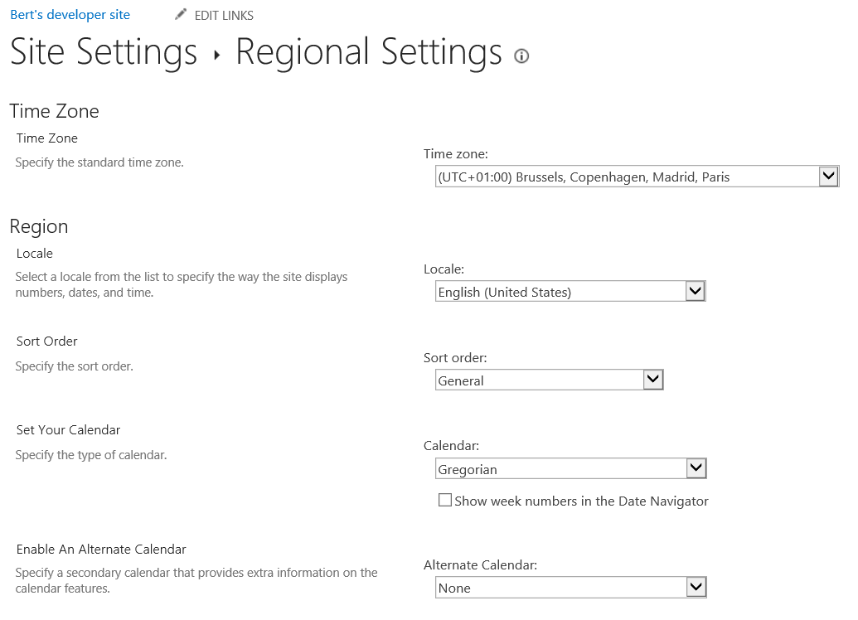
How to set the Region for a site
You want to automate language settings during site provisioning
We’re working on getting support for this in the client API’s but currently the only option is to use browser HTTP post mimicking. http://blogs.msdn.com/b/vesku/archive/2013/11/04/ftc-to-cam-advance-http-remote-operations-for-sp2013.aspx describes this in more detail.
Reading is possible via the RegionalSettings web property

Slide 8
How to set the Time Zone for a site
You want to automate time zone settings during site provisioning
During site collection provisioning Time Zone can be specified, but there’s no API. We’re working on getting support for this in the client API’s but currently the only option is to use browser HTTP post mimicking. http://blogs.msdn.com/b/vesku/archive/2013/11/04/ftc-to-cam-advance-http-remote-operations-for-sp2013.aspx describes this in more detail.
Reading is possible via the RegionalSettings web property

Slide 9
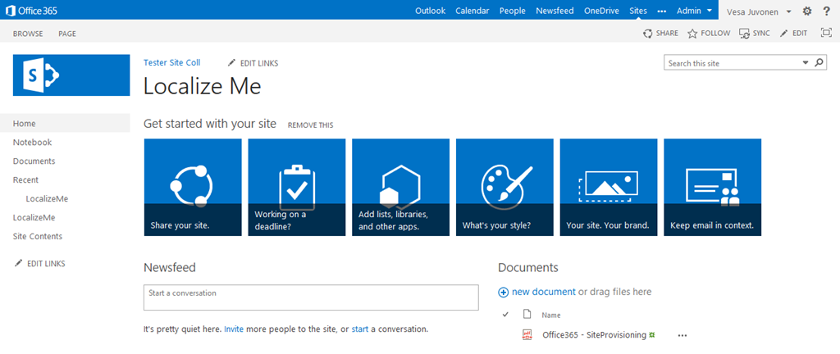
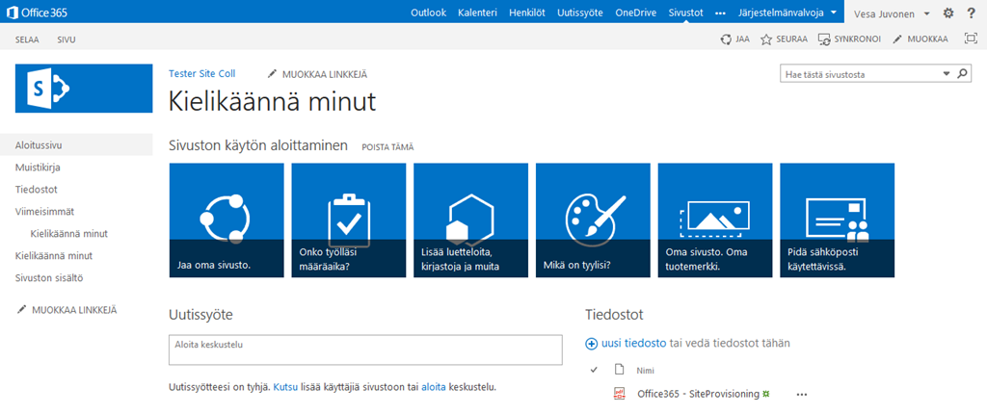
Translate site title and description

Slide 10
Set site title and description translations
web.TitleResource.SetValueForUICulture("nl-be", "Titel in het Nederlands");
web.DescriptionResource.SetValueForUICulture("nl-be", “Omschrijving in het Nederlands");
web.Update();
web.Context.ExecuteQuery();

Slide 11
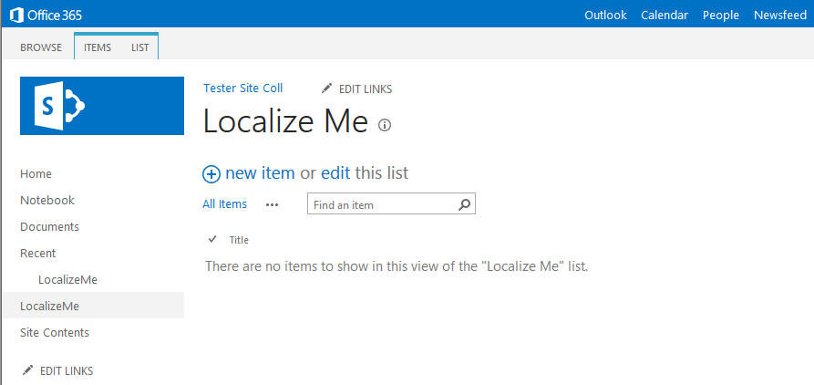
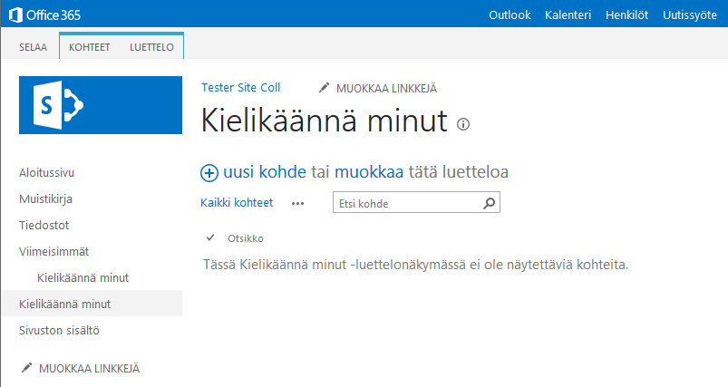
Translate list title and description

Slide 12
Set list title and description translations
list.TitleResource.SetValueForUICulture("nl-be", “Lijst titel in het Nederlands");
list.DescriptionResource.SetValueForUICulture("nl-be", “Lijst omschrijving in het Nederlands");
list.Update();
list.Context.ExecuteQuery();

Slide 13
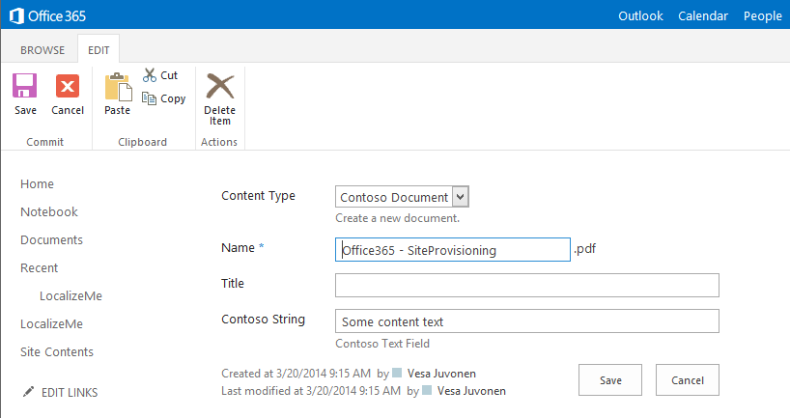
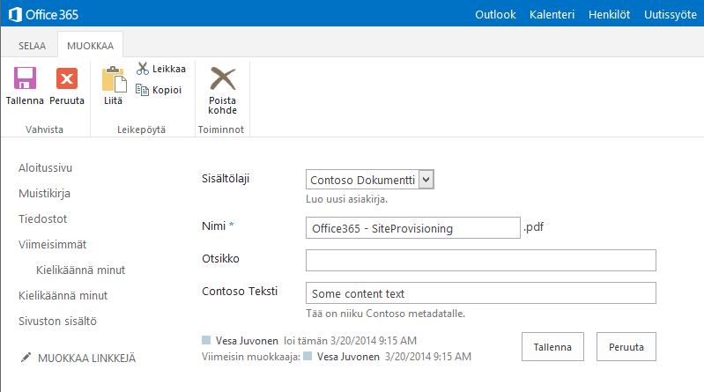
Translate content type name and description

Slide 14
Set Content type name and description translations
public static void SetLocalizationForContentType(this ContentType contentType, string cultureName, string nameResource, string descriptionResource)
{
if (contentType.IsObjectPropertyInstantiated("TitleResource"))
{
contentType.Context.Load(contentType);
contentType.Context.ExecuteQuery();
}
// Set translations for the culture
contentType.NameResource.SetValueForUICulture(cultureName, nameResource);
contentType.DescriptionResource.SetValueForUICulture(cultureName, descriptionResource);
contentType.Update(true);
contentType.Context.ExecuteQuery();
}

Slide 15
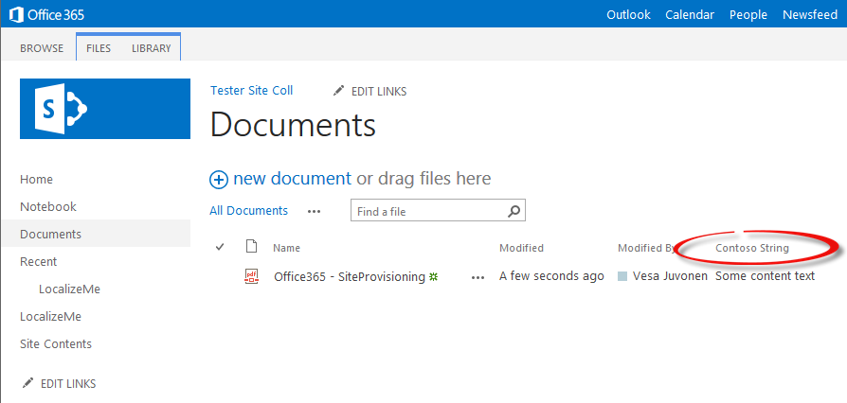
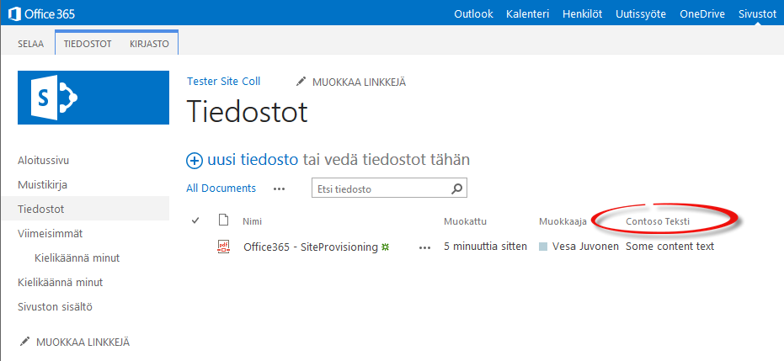
Translate site column title and description

Slide 16
Set Content type name and description translations
public static void SetLocalizationForField(this Field field, string cultureName, string titleResource, string descriptionResource)
{
if (string.IsNullOrEmpty(cultureName))
throw new ArgumentNullException("cultureName");
if (string.IsNullOrEmpty(titleResource))
throw new ArgumentNullException("titleResource");
if (field.IsObjectPropertyInstantiated("TitleResource"))
{
field.Context.Load(field);
field.Context.ExecuteQuery();
}
// Set translations for the culture
field.TitleResource.SetValueForUICulture(cultureName, titleResource);
field.DescriptionResource.SetValueForUICulture(cultureName, descriptionResource);
field.UpdateAndPushChanges(true);
field.Context.ExecuteQuery();
}

Slide 17
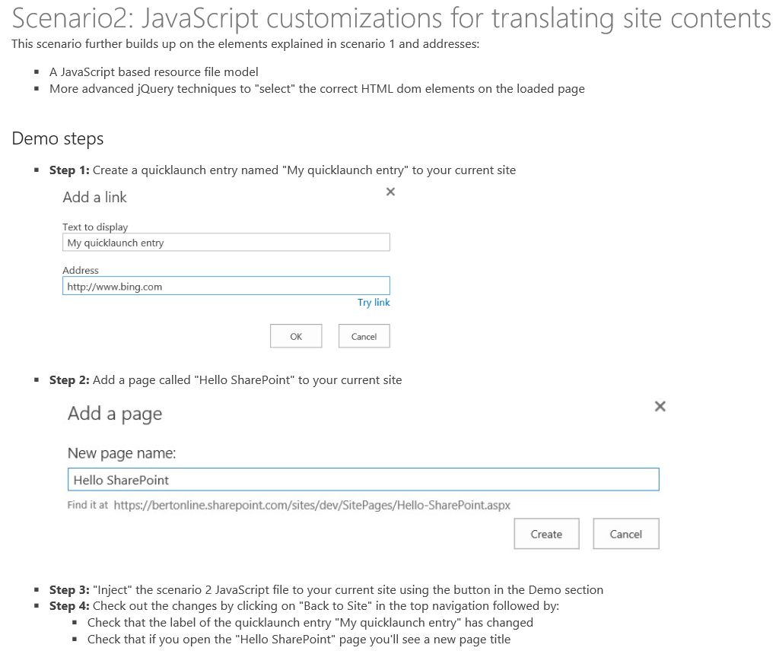
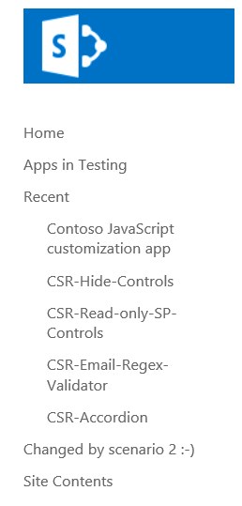
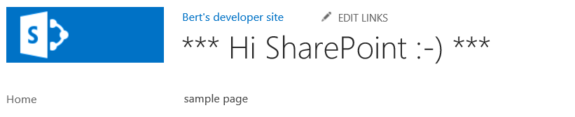
Translate other SharePoint site elements
Using JavaScript injection techniques you can “at runtime” selectively change HTML DOM elements. Applying translations in a possible use case of this technique.

Slide 18
Loading JavaScript resource files
var scriptUrl = "";
var scriptRevision = "";
// iterate the loaded scripts to find the scenario2 script.
// We use the script URL to dynamically build the url for the resource file
// to be loaded.
$('script').each(function (i, el) {
if (el.src.toLowerCase().indexOf('scenario2.js') > -1) {
scriptUrl = el.src;
scriptRevision = scriptUrl.substring(scriptUrl.indexOf('.js') + 3);
scriptUrl = scriptUrl.substring(0, scriptUrl.indexOf('.js'));
}
})
var resourcesFile = scriptUrl + "." + _spPageContextInfo.currentUICultureName.toLowerCase() + ".js" + scriptRevision;
// load the JS resource file based on the user's language
loadScript(resourcesFile, function () {
// your customizations go here
});

Slide 19
Applying the translations
// Note that you can use the jQuery each function to iterate all elements
// that match your jQuery selector.
$("span.ms-navedit-flyoutArrow").each(function () {
if (this.innerText.toLowerCase().indexOf('my quicklaunch entry') > -1) {
//update the label
$(this).find('.menu-item-text').text(quickLauch_Scenario2);
//update the tooltip
$(this).parent().attr("title", quickLauch_Scenario2);
}
});
// Change the title of the "Hello SharePoint" page
if (IsOnPage("Hello%20SharePoint.aspx")) {
$("#DeltaPlaceHolderPageTitleInTitleArea").find("A").each(function () {
if ($(this).text().toLowerCase().indexOf("hello sharepoint") > -1) {
//update the label
$(this).text(pageTitle_HelloSharePoint);
//update the tooltip
$(this).attr("title", pageTitle_HelloSharePoint);
}
});
}
Note: this technique relies on the HTLM DOM elements and thus your code might break if control names change. Only use this approach when you really need to.

Slide 20

Third party translation tools (coming)
There are ISV’s that will sell tools that can help with MUI implementations in SharePoint
http://www.icefire.ca/corp/products/pointfire+365/

Slide 21
Globalization and MUI for SharePoint apps

Slide 22
Challenges to tackle
How to translate your App UI
Declarative translation of app web and host web elements
Server side translations
Client side translations

Slide 23
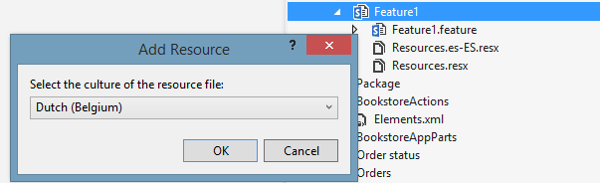
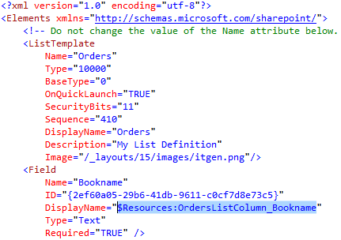
Translate App UI – Declarative – app web
Add feature resource files. Each feature requires it’s own feature resource file
Use the resources declaratively in the elements.xml and schema.xml files
See the “How to: Localize apps for SharePoint” to learn more: http://msdn.microsoft.com/en-us/library/office/fp179919(v=office.15).aspx

Slide 24
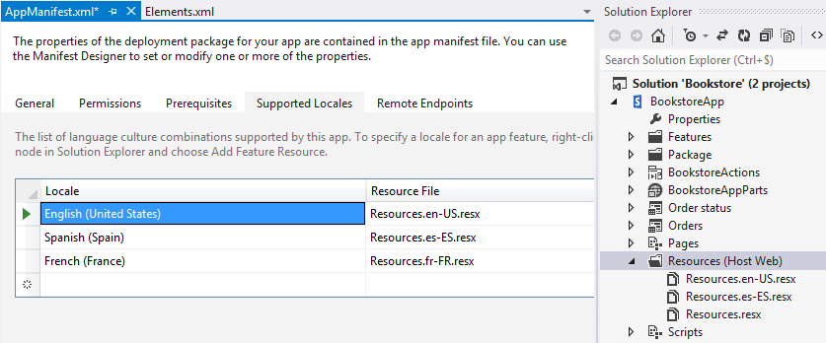
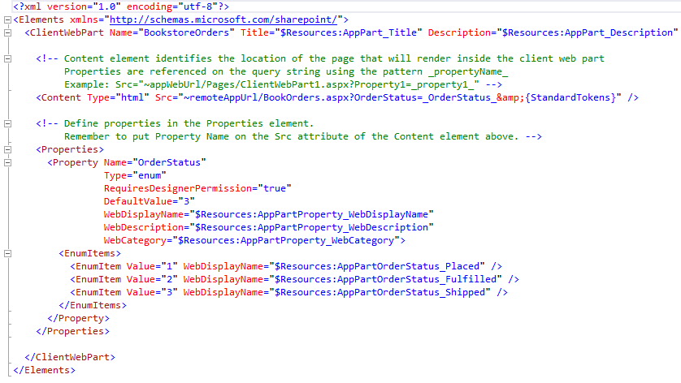
Translate App UI – Declarative – host web
Add app resource files by defining the supported locales in the app manifest
Use the resources declaratively in the elements.xml. Applies to custom actions, app parts but also other xml files that reflect in the host web (such as app title in the AppManifest.xml
See the “How to: Localize apps for SharePoint” to learn more: http://msdn.microsoft.com/en-us/library/office/fp179919(v=office.15).aspx

Slide 25
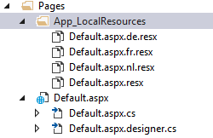
Translate App UI – Code - server side
Server side translation of the App UI in the Microsoft world is typically done using resource files.
See the “Localizing ASP.NET web pages by using resources” to learn more: http://msdn.microsoft.com/en-us/library/ms228208(v=vs.90).aspx

Slide 26
Translate the App UI – Code - server side
protected override void InitializeCulture()
{
string culture = Page.Request["SPLanguage"];
Page.Culture = culture;
Page.UICulture = culture;
Thread.CurrentThread.CurrentCulture = CultureInfo.CreateSpecificCulture(culture);
Thread.CurrentThread.CurrentUICulture = new CultureInfo(culture);
base.InitializeCulture();
}
<asp:Literal ID="Literal1" runat="server" Text="<%$Resources:h3Title%>" />
hdnErrorAcceptDisclaimer.Value = GetLocalResourceObject("hdnErrorAcceptDisclaimer.Value").ToString();
hdnErrorFillTitle.Value = GetLocalResourceObject("hdnErrorFillTitle.Value").ToString();
hdnErrorInvalidTitleChar.Value = GetLocalResourceObject("hdnErrorInvalidTitleChar.Value").ToString();
hdnErrorTitleTooLong.Value = GetLocalResourceObject("hdnErrorTitleTooLong.Value").ToString();
hdnErrorMissingOwners.Value = GetLocalResourceObject("hdnErrorMissingOwners.Value").ToString();
hdnErrorTooManyOwners.Value = GetLocalResourceObject("hdnErrorTooManyOwners.Value").ToString();
hdnErrorDuplicateOwners.Value = GetLocalResourceObject("hdnErrorDuplicateOwners.Value").ToString();
<div id="errorStrings" style="display:none;">
<asp:HiddenField ID="hdnErrorAcceptDisclaimer" runat="server" />
<asp:HiddenField ID="hdnErrorFillTitle" runat="server" />
<asp:HiddenField ID="hdnErrorInvalidTitleChar" runat="server" />
<asp:HiddenField ID="hdnErrorTitleTooLong" runat="server" />
<asp:HiddenField ID="hdnErrorMissingOwners" runat="server" />
<asp:HiddenField ID="hdnErrorTooManyOwners" runat="server" />
<asp:HiddenField ID="hdnErrorDuplicateOwners" runat="server" />
</div>
Take over the language used by the SharePoint side where the app is hosted
Use resource in a declarative way
Insert translated strings into the page so that they later on can be picked up by JavaScript for client side actions

Slide 27
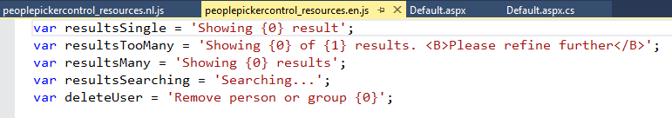
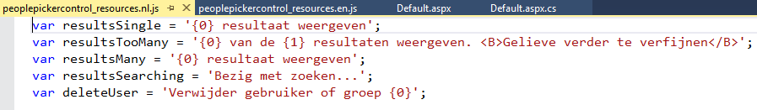
Translate App UI – Code - client side
When you use JavaScript to create/manipulate your app user interface you can work with JavaScript resource files
The correct JavaScript resource file needs to be loaded. The other JavaScript files just use the variables which then contain text in the requested language
See the “How to: Localize apps for SharePoint” to learn more: http://msdn.microsoft.com/en-us/library/office/fp179919(v=office.15).aspx

Slide 28
Translate the App UI – Code – client side
var scriptUrl = "";
var scriptRevision = "";
// iterate the loaded scripts to find the scenario2 script.
// We use the script URL to dynamically build the url for the resource file
// to be loaded.
$('script').each(function (i, el) {
if (el.src.toLowerCase().indexOf('scenario2.js') > -1) {
scriptUrl = el.src;
scriptRevision = scriptUrl.substring(scriptUrl.indexOf('.js') + 3);
scriptUrl = scriptUrl.substring(0, scriptUrl.indexOf('.js'));
}
})
var resourcesFile = scriptUrl + "." + _spPageContextInfo.currentUICultureName.toLowerCase() + ".js" + scriptRevision;
// load the JS resource file based on the user's language
loadScript(resourcesFile, function () {
// your customizations go here
});
Prepare the url for the JavaScript file to load by using the _spPageContextInfo.currentUICultureName property
Load the resource file and add the JavaScript code that depends on this in the function called after the load

Slide 29
Globalization and MUI for SharePoint publishing sites

Slide 30
Challenges to tackle
In publishing sites (intranets) it’s required to translate both the SharePoint UI and the content shown on the page
Following options are possible:
Use the out of the box variations system
Use a manual approach

Slide 31
Out of the box variations system
Variations are an infrastructure plumbing feature to enable multi-lingual sites
Provides the infrastructure for
Authoring
Organizing
Translating
Publishing
Redirecting

Slide 32
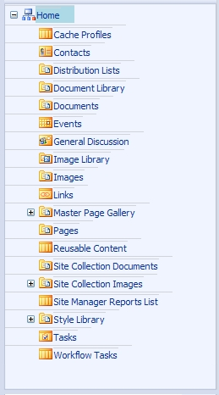
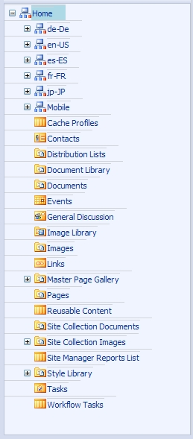
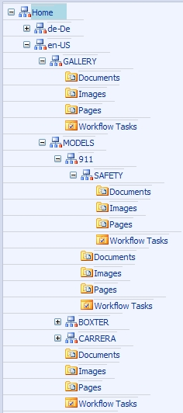
Out of the box variations system : Site Hierarchy
For each label a new site is created under the Variation Root (in this case “Home”)
Each label contains the content for that variation.
Notes:
9/16/2014 11:11 AM
© 2005 Microsoft Corporation. All rights reserved.
This presentation is for informational purposes only. Microsoft makes no warranties, express or implied, in this summary.
32

Slide 33
Use manual approach
Sometimes variations is too strict because you want to give the language sites a different structure or use multiple authoring languages
Creating multiple independent publishing sites with a language redirect on the “master” site can be a solution

Slide 34

Questions?

Slide 35


© 2014 Microsoft Corporation. All rights reserved. Microsoft, Windows, and other product names are or may be registered trademarks and/or trademarks in the U.S. and/or other countries.
The information herein is for informational purposes only and represents the current view of Microsoft Corporation as of the date of this presentation. Because Microsoft must respond to changing market conditions, it should not be interpreted to be a commitment on the part of Microsoft, and Microsoft cannot guarantee the accuracy of any information provided after the date of this presentation. MICROSOFT MAKES NO WARRANTIES, EXPRESS, IMPLIED OR STATUTORY, AS TO THE INFORMATION IN THIS PRESENTATION.

